Slide 1
Scientific Machine Learning for Modeling, Optimization, and Control of Dynamical Systems
Ján Drgoňa
Associate Professor Civil and Systems Engineering Department The Ralph O'Connor Sustainable Energy Institute (ROSEI)
Data Science and AI Institute (DSAI)

Slide 2
Course Syllabus
Week 1: Introduction to Scientific Machine Learning (SciML)
Week 2: Preliminaries and Introduction to differentiable programming
Week 3: Physics-informed neural networks (PINNs)
Week 4: Neural ordinary differential equations (NODEs)
Week 5: Learning to optimize (L2O)
Week 6: Optimal control preliminaries
Week 7: Differentiable predictive control (DPC)
Week 8: Neural differential equations with constraints
Week 9: Feasibility restoration methods in L2O
Week 10: Safety filters for learning-based control
Week 11: Project evaluation with presentations
Week 12: Project evaluation with presentations

Slide 3



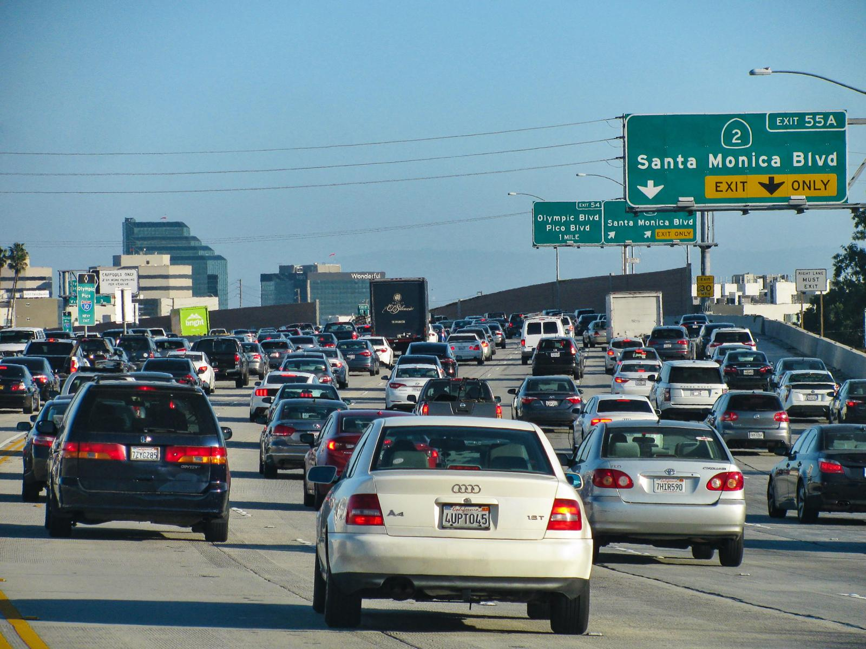

Applications of Optimal Control in Energy Systems

Slide 4
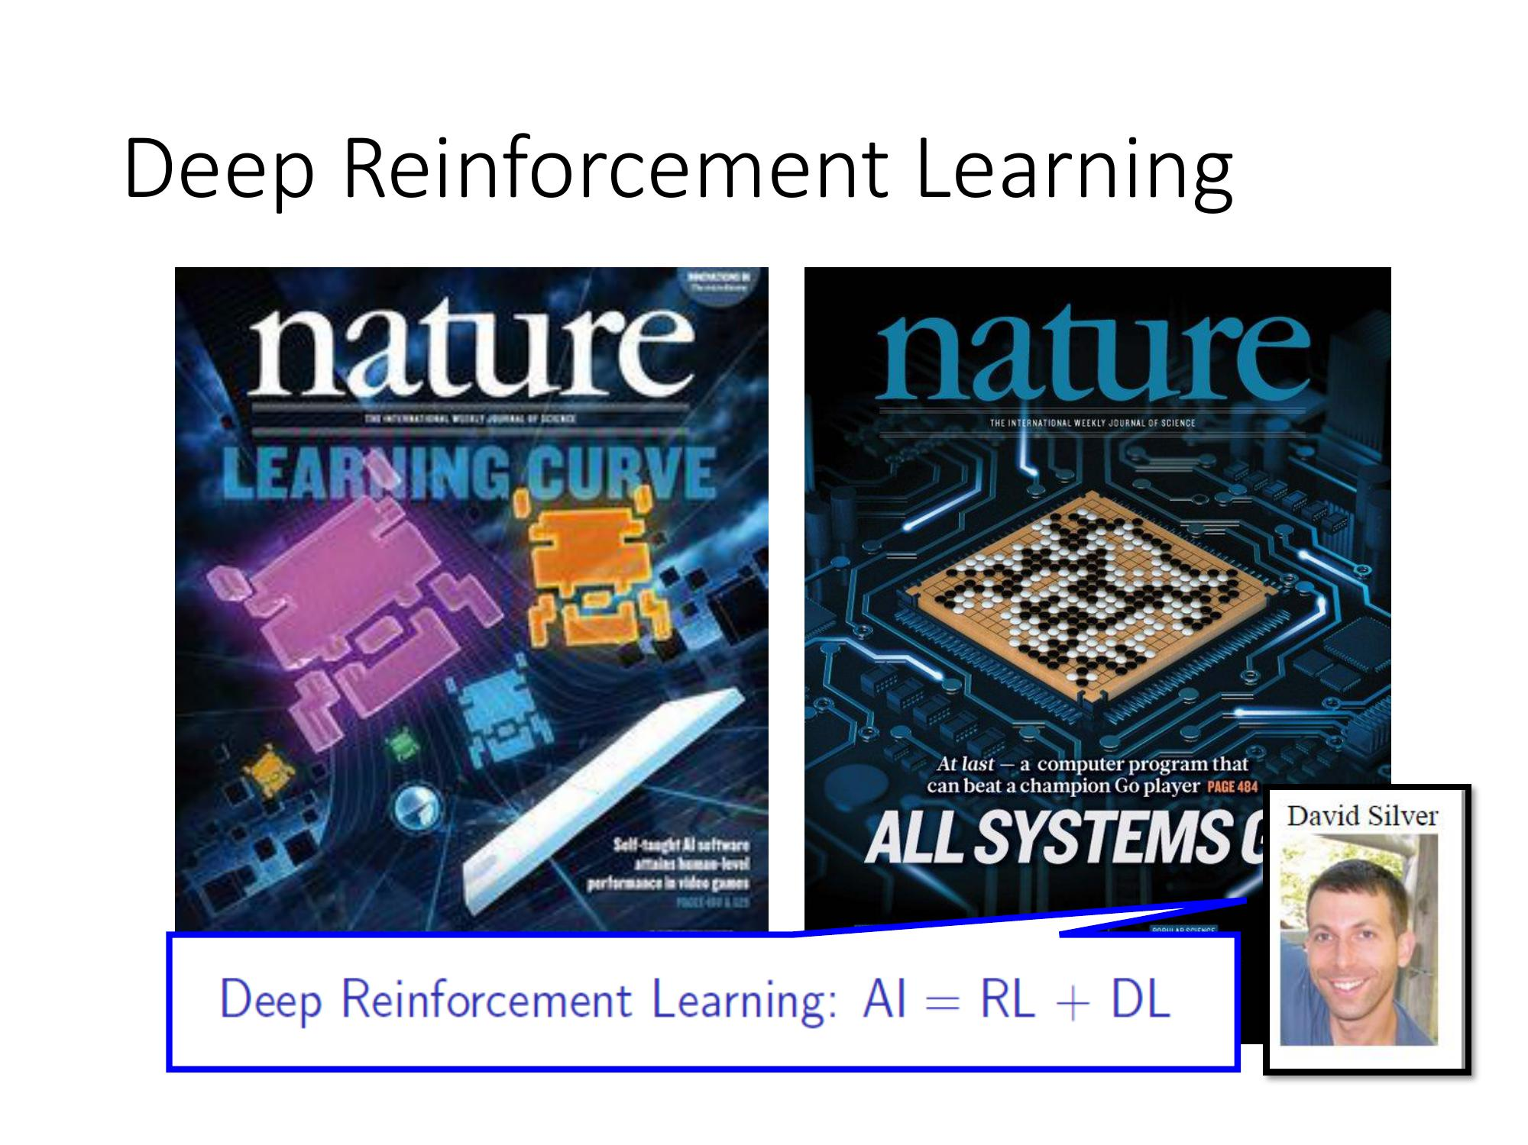
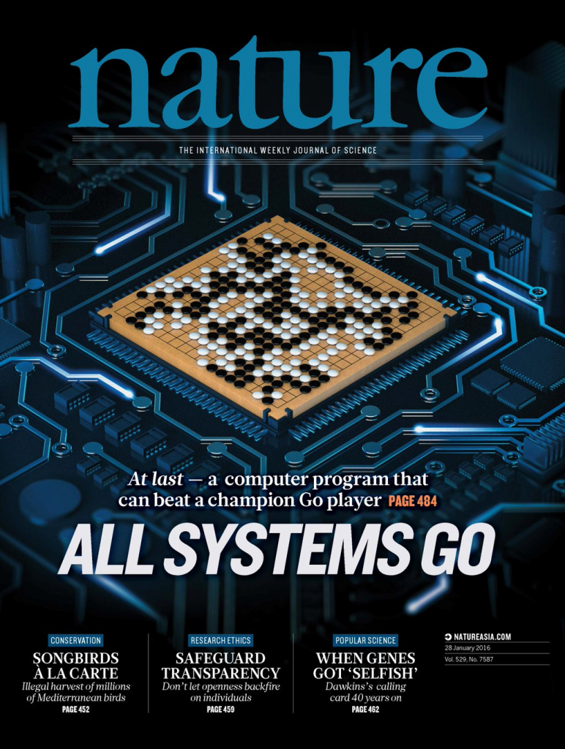
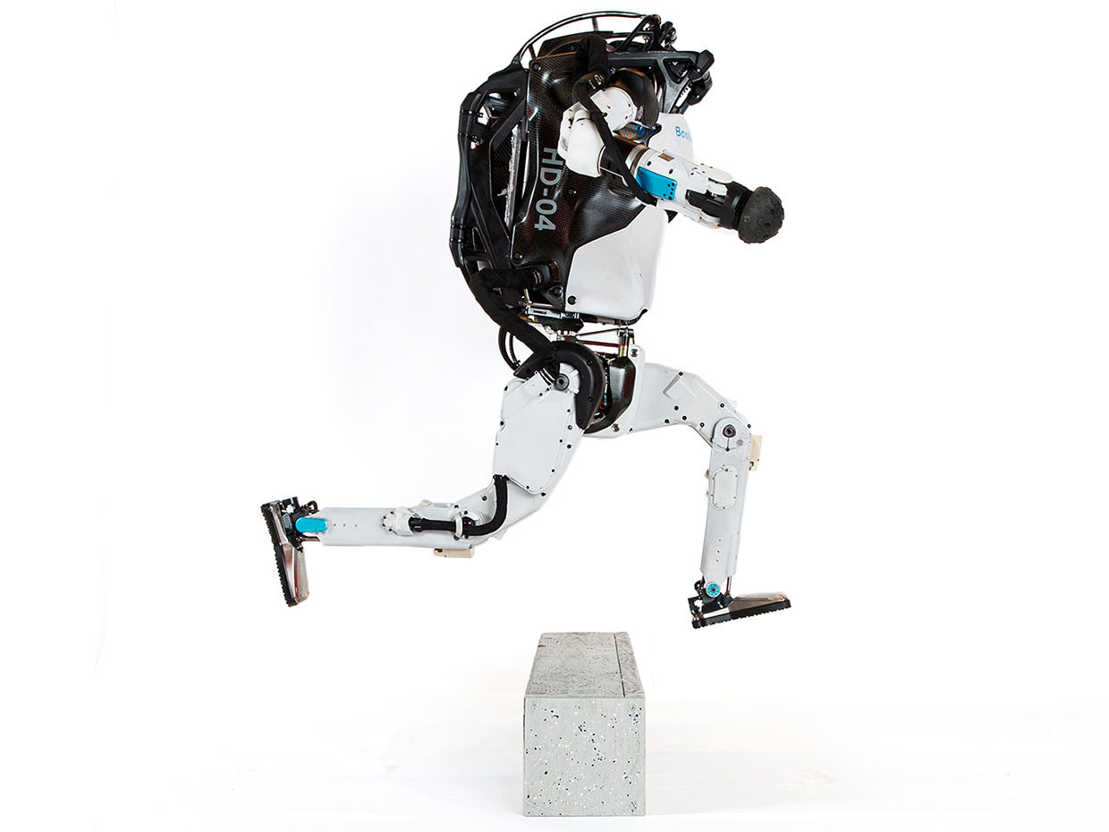
State of the Art Optimal Control Methods
Model Predictive Control
Reinforcement Learning
95% of the industrial control applications are PID loops & expert driven rule-based control (RBC).
The rest is model predictive control (MPC).
Everywhere where you have reliable digital environment model, and you can use compute resources to solve the problem offline. Successful in GenAI, games, and robotics.
James B. Rawlings, David Q. Mayne, Moritz M. Diehl, Model Predictive Control: Theory and Design, Nob Hill Publishing, 2nd ed., 2017
Richard S. Sutton and Andrew G. Barto, Reinforcement Learning: An Introduction, MIT Press, 2nd ed., 2018 Drgona J., et al. 2020. "All You Need to Know About Model Predictive Control for Buildings." Annual Reviews in Control, September 29, 2020
G. Dulac-Arnold, D. J. Mankowitz, and T. Hester, “Challenges of real-world reinforcement learning,”, 2019.

Slide 5
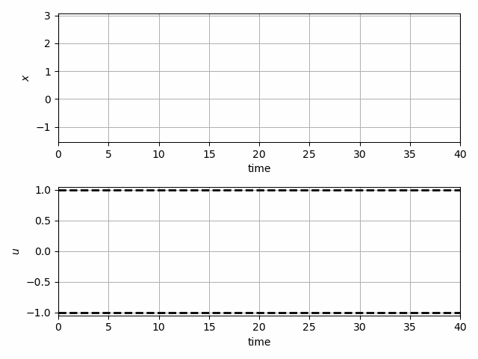
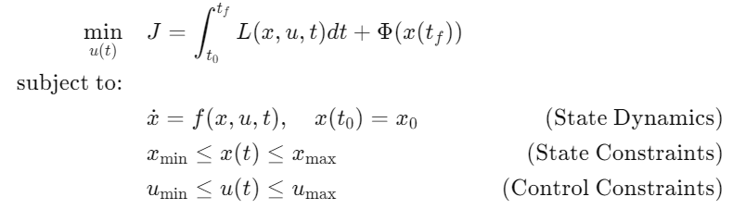
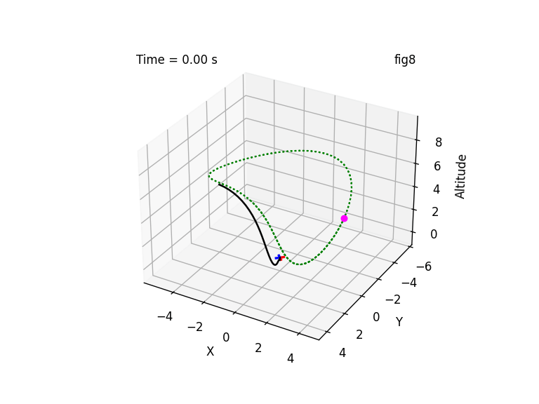
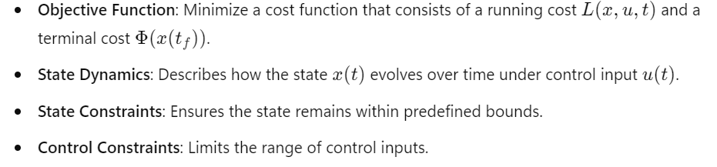
Optimal Control Problem
Optimal control is a mathematical framework used to determine control policies that optimize a given objective function while satisfying dynamic system constraints.
Standard optimal control problem formulation:
https://en.wikipedia.org/wiki/Optimal_control

Slide 6
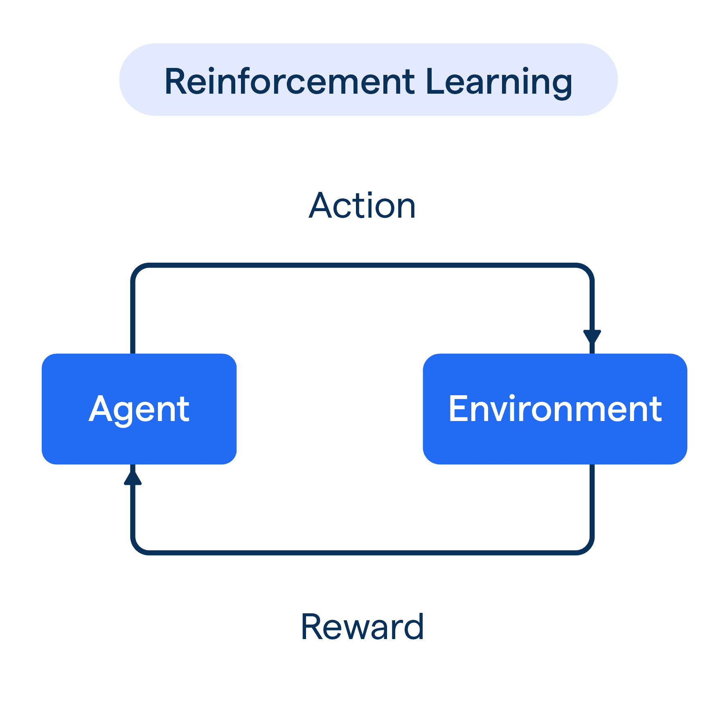
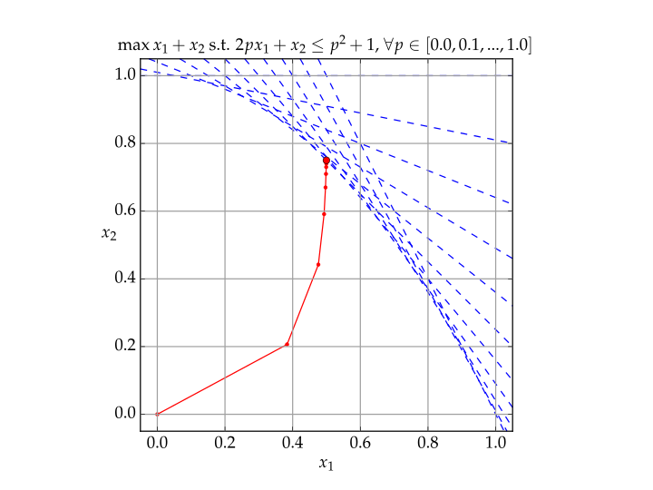
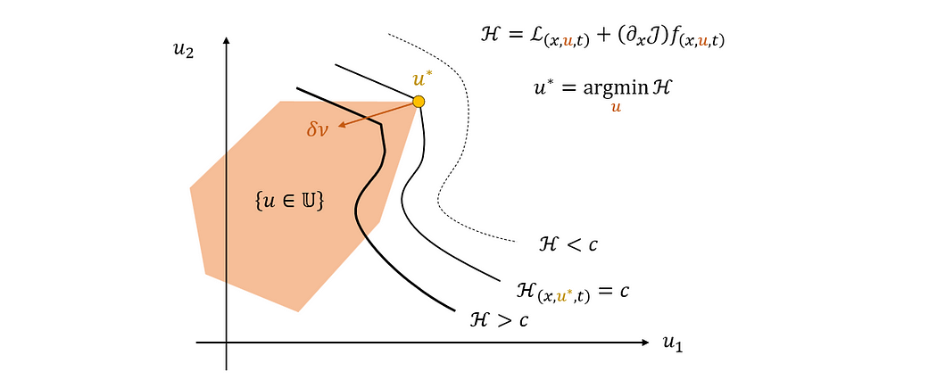

Solution Methods for Optimal Control Methods
Analytical Methods
Numerical Methods
Data-driven Methods
Pontryagin’s Maximum Principle (Indirect method)
Bellman’s Principle of Optimality
(Dynamic Programming)
Direct numerical discretization methods that convert OCP into a constrained optimization problem
Approximate dynamic programming
Reinforcement Learning
www.syscop.de/teaching/ss2020/numerical-optimal-control-online

Slide 7
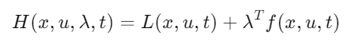
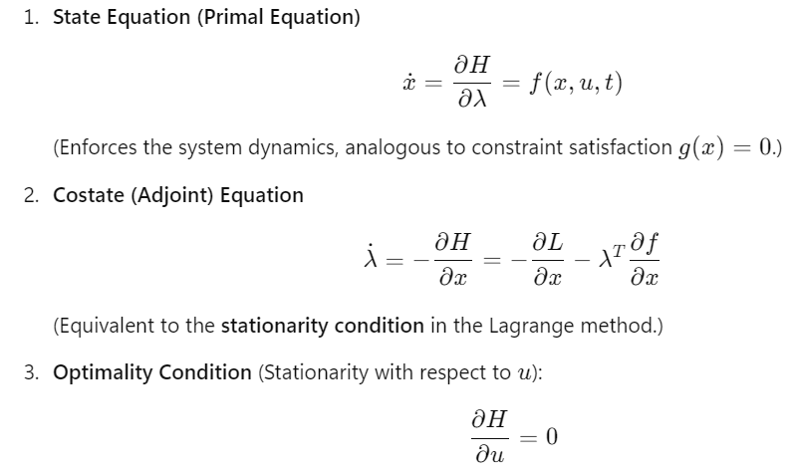
Pontryagin’s Maximum Principle (PMP)
PMP extends the Lagrange multiplier method from static optimization (where constraints are algebraic equations) to dynamic systems (where constraints are differential equations).
Hamiltonian (Dynamic Lagrangian):
Adjoint (costate) variables λ(t), act as time-dependent Lagrange multipliers enforcing the system dynamics.
https://en.wikipedia.org/wiki/Pontryagin%27s_maximum_principle

Slide 8
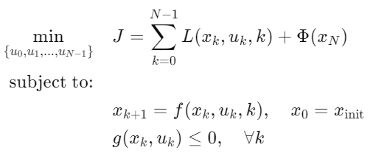
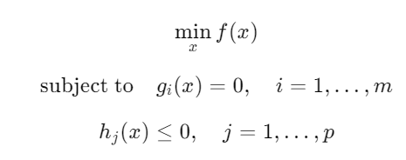
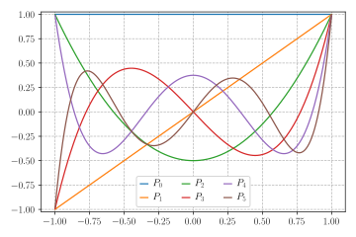
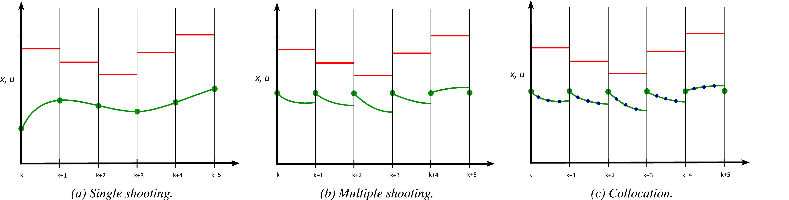
Direct Numerical Methods for Optimal Control
Transform the OCP into a finite-dimensional nonlinear programming (NLP) problem, which is then solved using numerical optimization techniques. These methods discretize the state and control variables directly, avoiding the need to solve the costate (adjoint) equations, unlike indirect methods.
Step 1: discretize OCP
Step 2: translate to OP
Single shooting
Multiple shooting
Direct collocation
Control functions parametrization
Step 3: optimize OP
Control parametrization via Legendre polynomials
Matthew P. Kelly Transcription Methods for Trajectory Optimization: a beginners tutorial arXiv:1707.00284

Slide 9
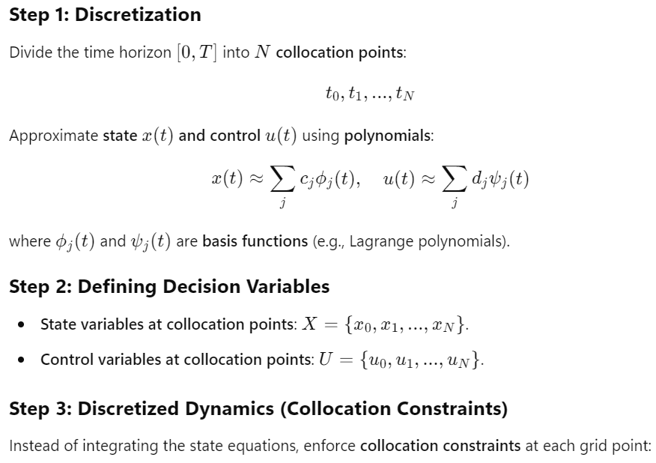
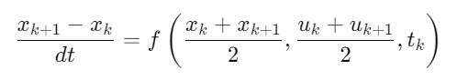
Direct Collocation Method
Is a direct numerical approach that transforms an optimal control problem into a constrained optimization problem by discretizing both state and control variables at collocation points via polynomial approximations.
This method is particularly useful for handling complex constraints and stiff or nonlinear systems.
https://en.wikipedia.org/wiki/Collocation_method

Slide 10
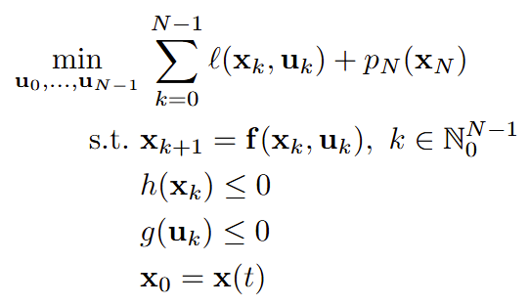
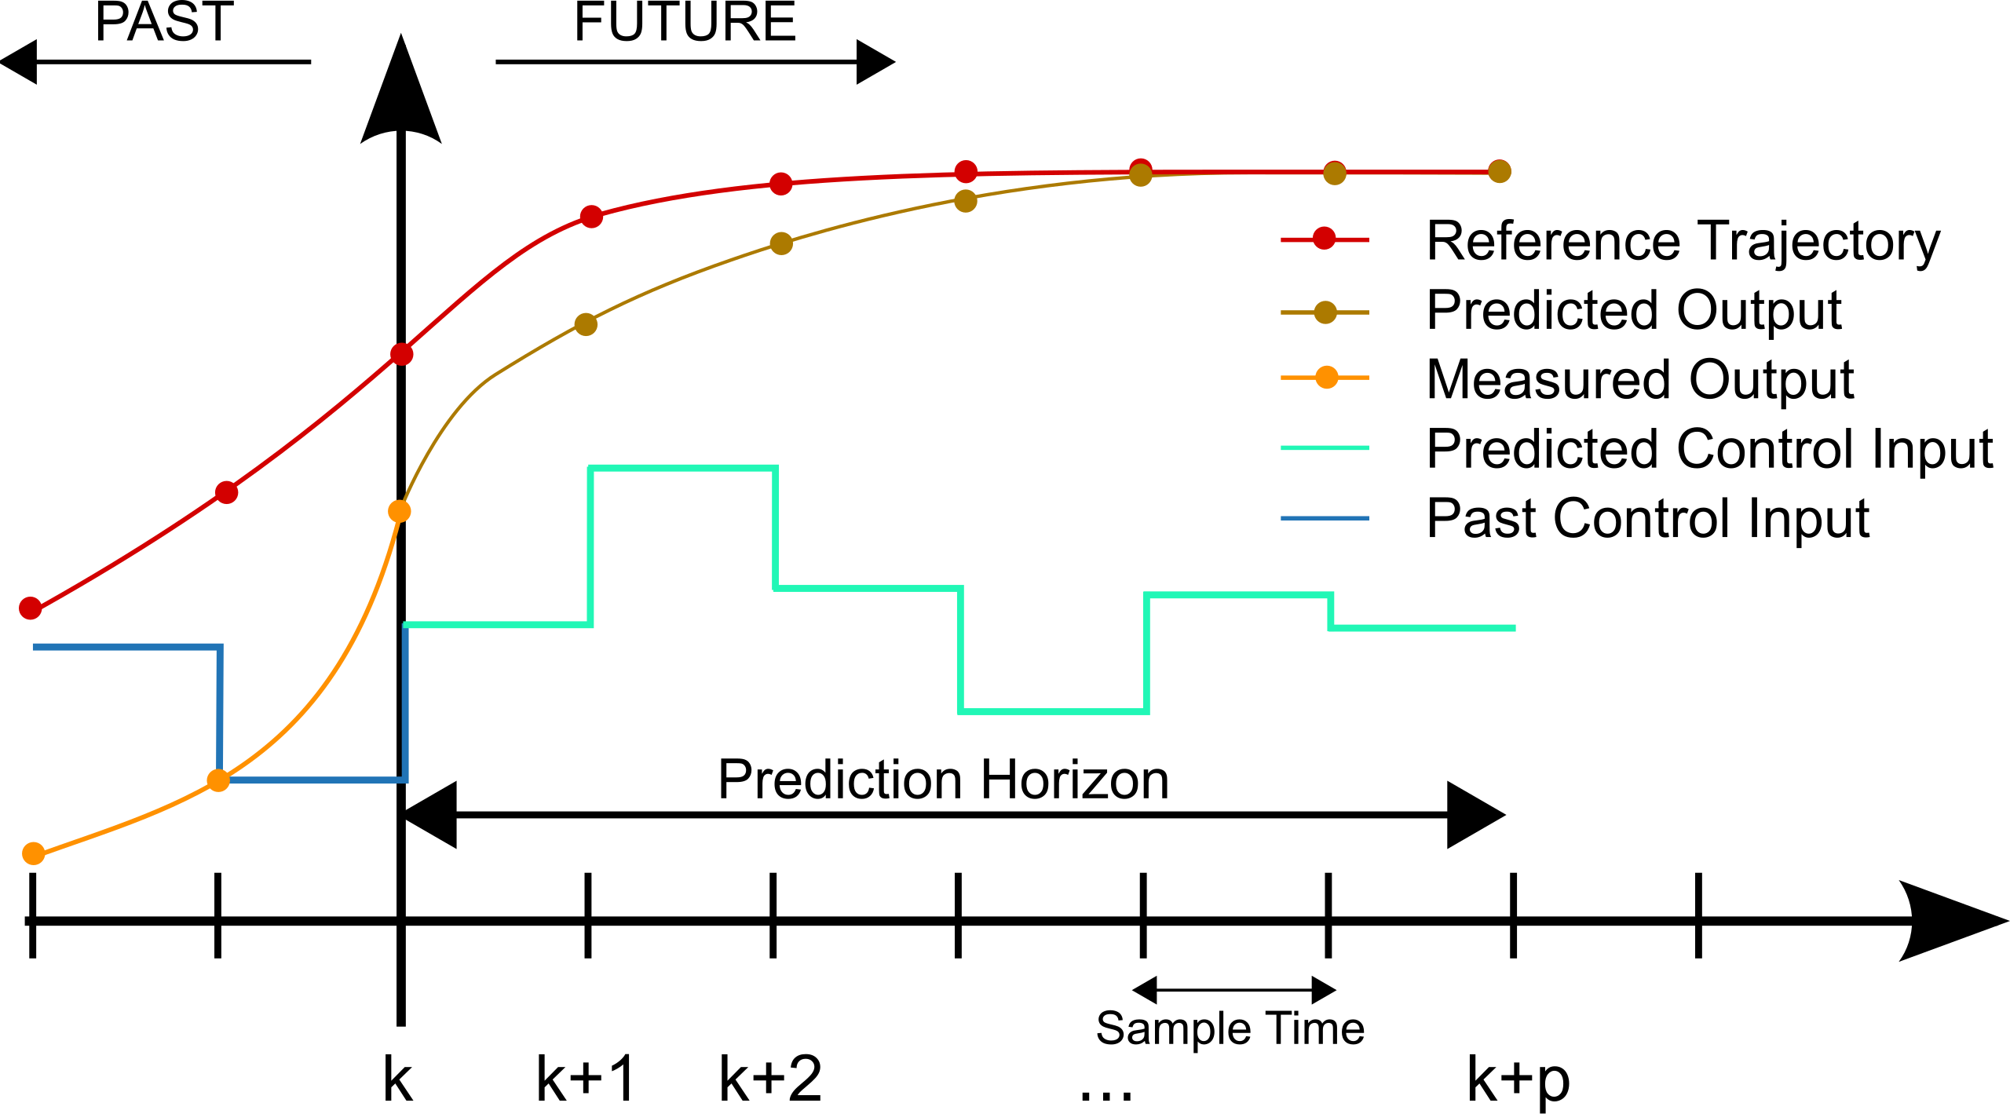
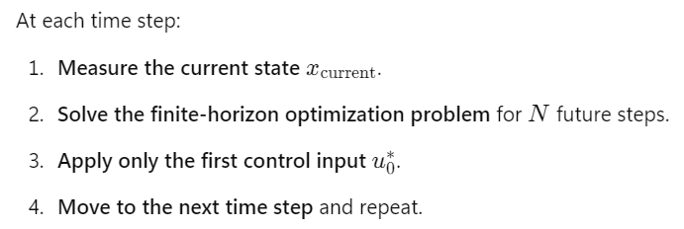
Model Predictive Control (MPC)
MPC uses a receding horizon approach to compute the optimal control input at each time step by solving a finite-horizon optimal control problem in real-time via online optimization using numerical methods.
Finite-horizon optimal control problem formulation:
James B. Rawlings, David Q. Mayne, Moritz M. Diehl, Model Predictive Control: Theory and Design, Nob Hill Publishing, 2nd ed., 2017

Slide 11
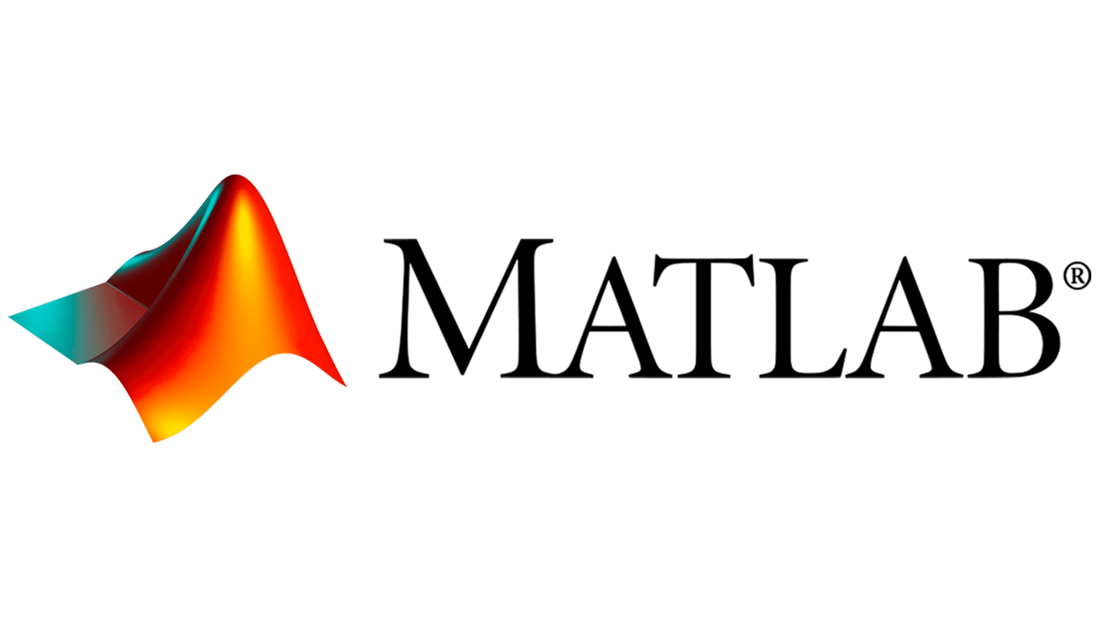



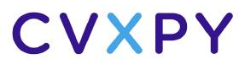

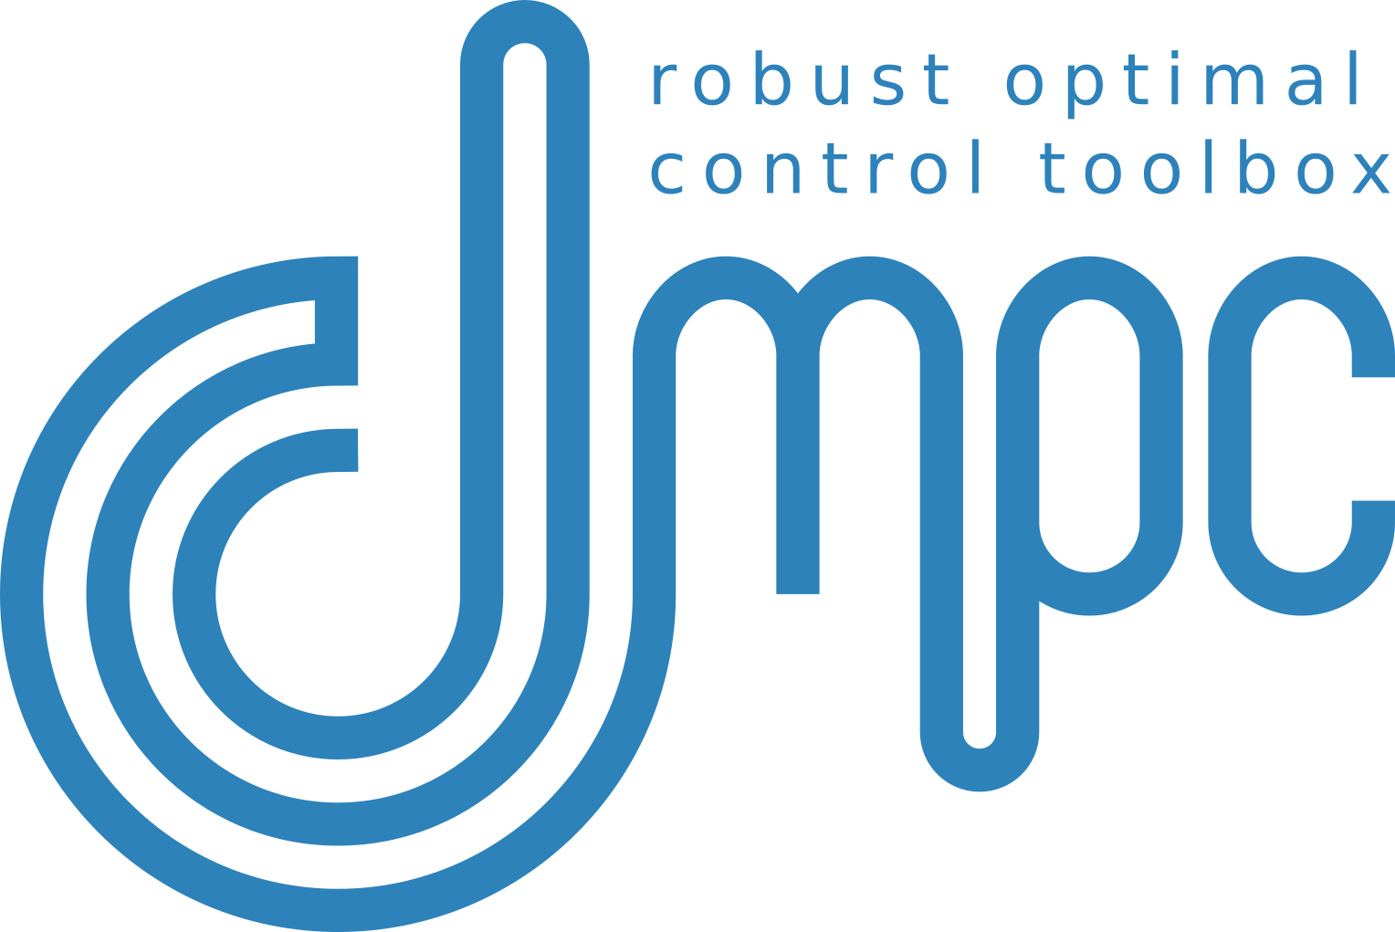

Model Predictive Control (MPC)
MPC uses a receding horizon approach to compute the optimal control input at each time step by solving a finite-horizon optimal control problem in real-time via online optimization using numerical methods.
Finite-horizon optimal control problem formulation:
MPC software tools:
Challenges: Computationally expensive online.
James B. Rawlings, David Q. Mayne, Moritz M. Diehl, Model Predictive Control: Theory and Design, Nob Hill Publishing, 2nd ed., 2017

Slide 12
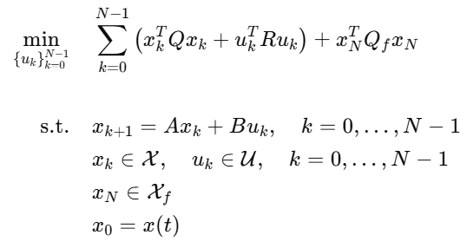
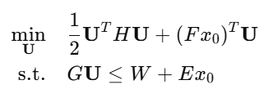
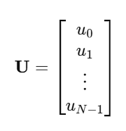
Linear MPC
Linear MPC is a special case of MPC where the system dynamics, and constraints are all linear and cost function is linear or quadratic. This simplifies the optimization problem into a Quadratic Programming (QP) problem, which is much faster to solve compared to nonlinear MPC.
Linear MPC problem formulation:
QP problem formulation:
Question: how to translate a linear MPC problem into a QP problem?
Juan L. Jerez, Eric C. Kerrigan, George A. Constantinides, A sparse and condensed QP formulation for predictive control of LTI systems, Automatica, Volume 48, Issue 5,2012.

Slide 13
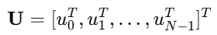
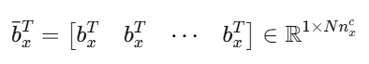
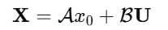
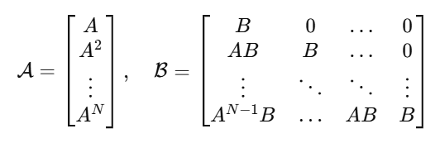
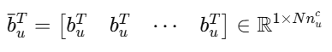
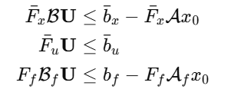
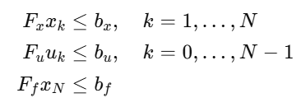
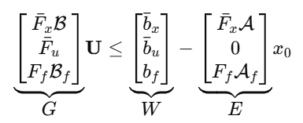
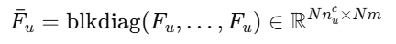
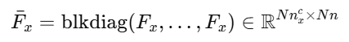
Dense Form (Single Shooting) of Linear MPC
Dense form of state equations over horizon N :
Stacked constraints vectors:
Substitute X and U into stacked constraints:
Standard form of constraints:
Final dense form of constraints:
Stacked constraints vectors:

Slide 14
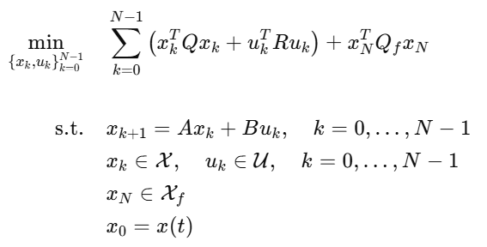
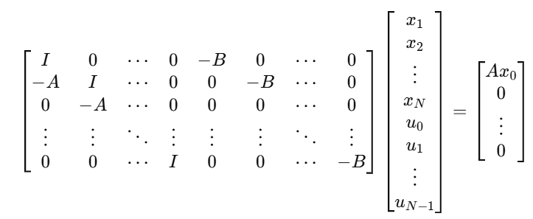
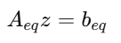
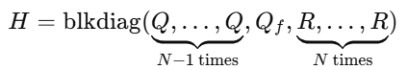
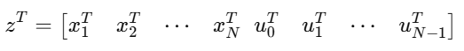
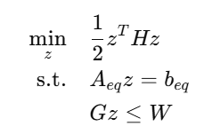
Sparse Form (Multiple Shooting) of Linear MPC
In multiple shooting, both state variables and control inputs are treated as decision variables.
MPC problem formulation:
Sparse form of state equations over horizon N :
Stacked constraints:
Decision variables (states and inputs):
Stacked objective:
Final sparse QP form:
State equations as equality constraints:

Slide 15
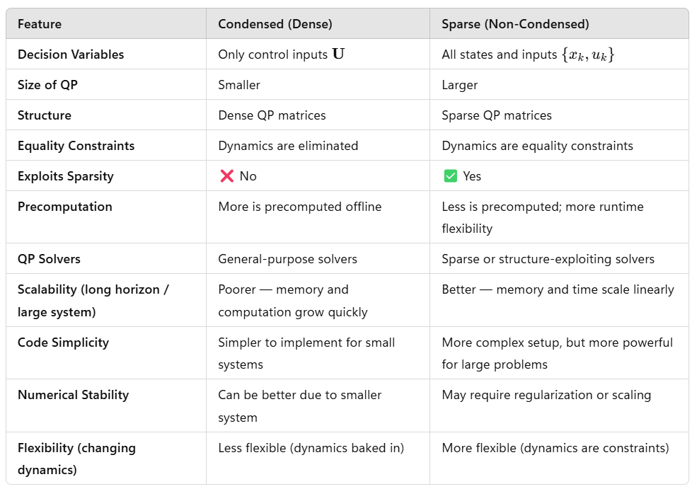
Dense vs Sparse Linear MPC Formulations

Slide 16
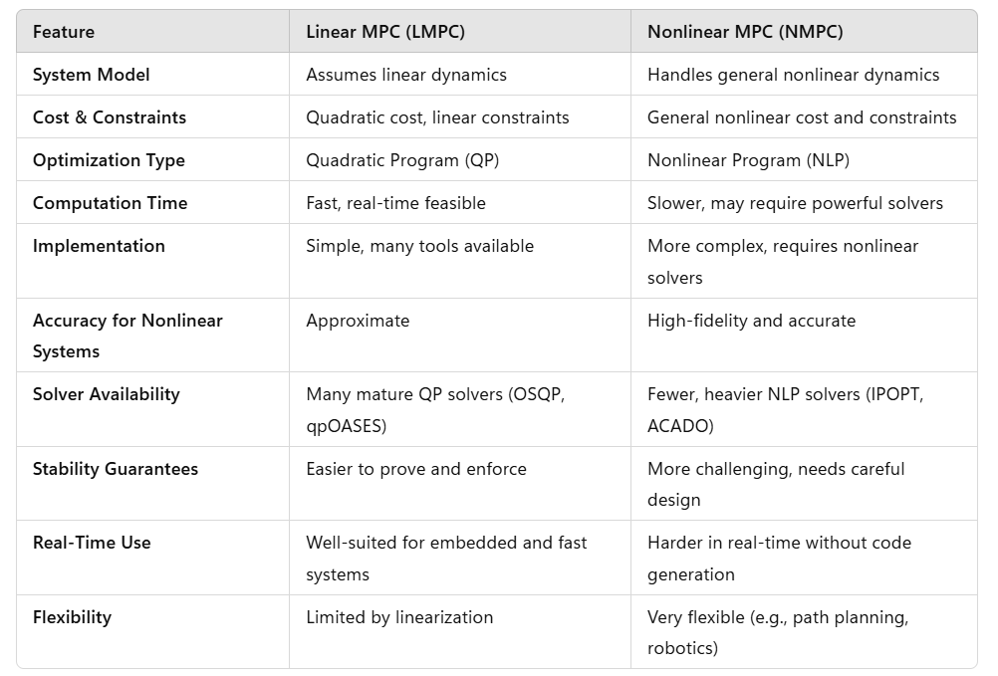
Linear vs Nonlinear MPC

Slide 17
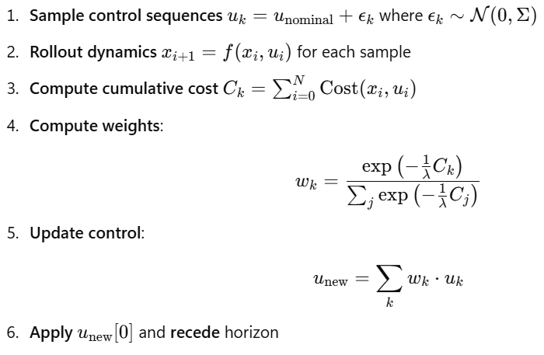
Model Predictive Path Integral (MPPI) Control
MPPI is a sampling-based stochastic optimal control method within the broader family of MPC techniques. It is particularly well-suited for nonlinear systems, uncertain dynamics, and control problems with complex, nonconvex cost landscapes where real-time performance is critical.
Instead of solving an optimization problem analytically or via numerical solvers, MPPI does:
Samples many control input sequences from a distribution.
Simulates the system using a model for each sequence.
Evaluates the cost of each trajectory based on MPC objective.
Uses a path integral weighting (softmax-like) to compute a weights of control signals.
Update control sequence as a weighted average of the noise signal.
Applies the first control input from the best distribution (receding horizon control).
https://sites.gatech.edu/acds/mppi/ https://en.wikipedia.org/wiki/Path_integral_formulation

Slide 18
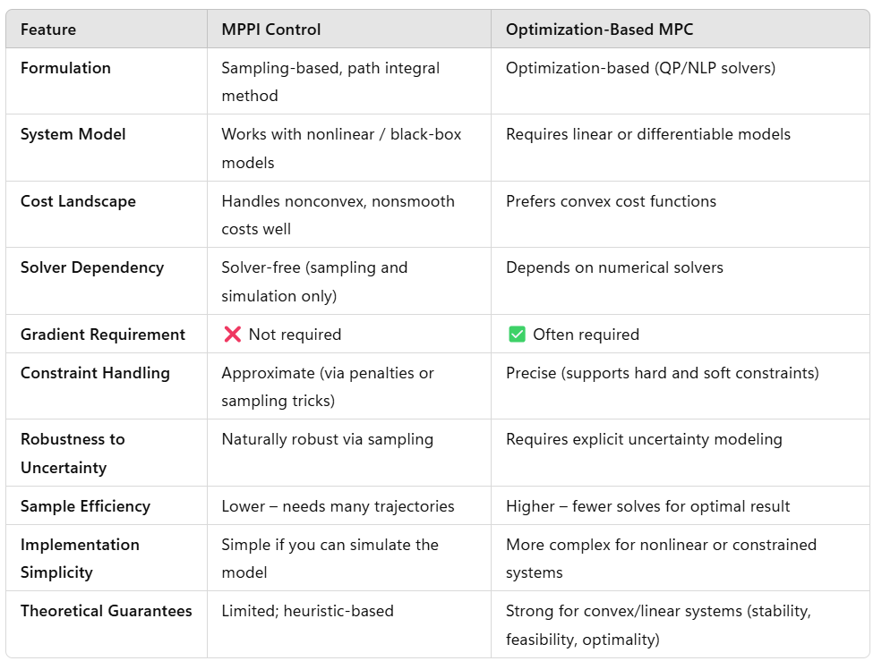
MPPI vs Optimization-Based MPC

Slide 19
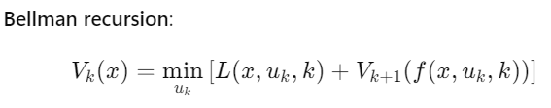
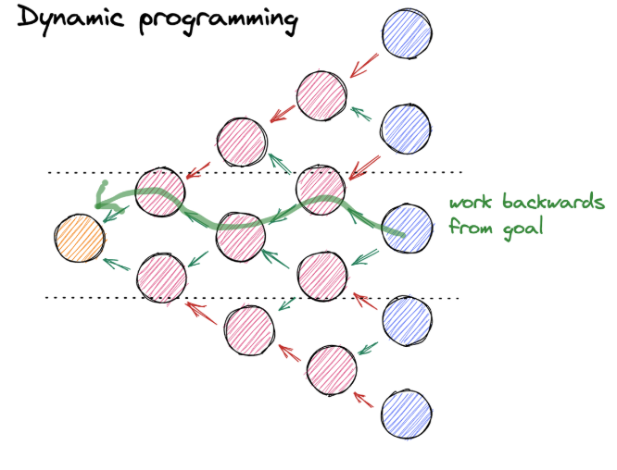




Dynamic Programming (DP)
DP solves OCP using the principle of optimality and the Hamilton-Jacobi-Bellman (HJB) equation. It simplifies a complicated problem by breaking it down into smaller sub-problems in a recursive manner.
Bellman’s Principle of Optimality: "An optimal policy has the property that, regardless of the initial state and decision, the remaining decisions must constitute an optimal policy with respect to the state resulting from the first decision."
Image created by:
Colin LaMont
https://en.wikipedia.org/wiki/Dynamic_programming
https://en.wikipedia.org/wiki/Hamilton%E2%80%93Jacobi%E2%80%93Bellman_equation

Slide 20




Approximate Dynamic Programming (ADP)
ADP is a method for solving DP problems when the state and action spaces are too large for exact computation of optimal value function. It uses approximation techniques to estimate value functions or policies.
Problem: When the state space is large or continuous, storing and computing V_{k}(x) exactly is expensive.
Key Idea: Instead of storing the entire value function, learn an approximation that generalizes across states.
https://en.wikipedia.org/wiki/Dynamic_programming
https://en.wikipedia.org/wiki/Reinforcement_learning

Slide 21





Reinforcement Learning (RL)
RL is a data-driven decision-making framework where an agent interacts with an environment to learn an optimal policy that maximizes rewards over infinite-horizon. Most modern policy-gradient methods (actor–critic, PPO, TRPO, DDPG, TD3, offline RL) learn a critic and use it to update the actor (policy).
1, Data collection via sampling:
2, Critic Update:
Q-function
Bellman target
Critic loss function
3, Actor update via deterministic policy gradient:
4, Gradient descent updates:
Richard S. Sutton and Andrew G. Barto, Reinforcement Learning: An Introduction, MIT Press, 2nd ed., 2018

Slide 22




Reinforcement Learning (RL)
RL is a data-driven decision-making framework where an agent interacts with an environment to learn an optimal policy that maximizes rewards over infinite-horizon. Most modern policy-gradient methods (actor–critic, PPO, TRPO, DDPG, TD3, offline RL) learn a critic and use it to update the actor (policy).
1, Data collection via sampling:
2, Critic Update:
Q-function
Bellman target
Critic loss function
3, Actor update via deterministic policy gradient:
RL software tools:
4, Gradient descent updates:
Challenges: Sample inefficient! Hard to obtain guarantees.
Richard S. Sutton and Andrew G. Barto, Reinforcement Learning: An Introduction, MIT Press, 2nd ed., 2018

Slide 23




Model-Based Reinforcement Learning (MBRL)
MBRL aims to improve sample efficiency by learning a predictive model of the environment dynamics and using it to simulate trajectories for Q-function fitting and policy optimization. This framework is followed by methods such as MBPO, TD3-MB, MOPO, COMBO, DreamerV3, and Plan2Explore.
1, Model rollouts via sampling:
2, Critic Update using model rollouts:
Bellman target
Critic loss function
3, Actor update via deterministic policy gradient:
4, Gradient descent updates:
Image: www.geeksforgeeks.org/artificial-intelligence/model-based-reinforcement-learning-mbrl-in-ai/
Richard S. Sutton and Andrew G. Barto, Reinforcement Learning: An Introduction, MIT Press, 2nd ed., 2018

Slide 24
Model-Based Reinforcement Learning (MBRL)
MBRL aims to improve sample efficiency by learning a predictive model of the environment dynamics and using it to simulate trajectories for Q-function fitting and policy optimization. This framework is followed by methods such as MBPO, TD3-MB, MOPO, COMBO, DreamerV3, and Plan2Explore.
1, Model rollouts via sampling:
2, Critic Update using model rollouts:
Bellman target
Critic loss function
Why to learn the critic if we have accurate and differentiable model and parametric reward functions?
3, Actor update via deterministic policy gradient:
4, Gradient descent updates:
Image: www.geeksforgeeks.org/artificial-intelligence/model-based-reinforcement-learning-mbrl-in-ai/
Richard S. Sutton and Andrew G. Barto, Reinforcement Learning: An Introduction, MIT Press, 2nd ed., 2018

Slide 25
Optimal Control Modeling Languages and Solvers
https://www.pyomo.org/
https://www.cvxpy.org/
https://jump.dev/JuMP.jl/stable/
https://web.casadi.org/
https://gekko.readthedocs.io/
https://www.gurobi.com/

Slide 26
Homework Assignment: Project Proposal
Project proposal: Based on the feedback from this week update the 2-page proposal.
The proposal must include following paragraphs:
Summary: Single sentence providing concise overview of the proposal.
Introduction: Provides context and problem statement. Answers what is the problem and why is the problem important.
Objectives: States clear and specific objectives of the proposal. Answers what we want to achieve.
Technical approach: Detailed explanation of how the project will be executed. Provides steps, strategies, and techniques to be used. Answers how are we going to achieve our objectives.
Expected outcomes: Key results expected from the project. Performance indicators and success metrics.

Slide 27
Week 11: Project Presentations and Evaluation
Projects cover 70% of the course grade!
Project proposal 20% - week 5
Project progress report 10% - week 8
Project final report 20% - week 10
Project presentation 20% - week 11
Project format.
Project technical report: 4 to 6 page long pdf document including references and figures.
Project presentation: ppt or pdf slides, 15 min time slot per student in week 11.
Admissible topics.
Application of selected SciML methods to problems inspired by real-world applications
e.g., L2O for large scale optimization of energy systems.
Development of new methods tackling some of the open challenges in SciML
e.g., novel way of utilizing PINNs in differentiable control for PDEs.
New theory supporting selected SciML methodology
e.g., convergence analysis of feasibility restoration layers in L2O.

